Slide 1

Airbnb price analysis
Ali Khatami
DSC530 - T301

Slide 2
Statistical Question/Hypothesis: 1. What factors affect the Airbnb rental prices in Europe? 2. How do Airbnb prices vary across cities in Europe? Which variables have the greatest impact on the price of a property? 3. Which variables have the greatest impact on the price of a property?

Slide 3
Variables
Variables | Description
bedrooms | number of bedrooms
realSum | price of the rental houses
person_capacity | maximum number of guests
room_type | type of room
room_private | dummy for private rooms
room_shared | dummy for shared rooms
cleanliness_rating | guest reviews: scale to 10
guest_satisfaction_overall | guest reviews: scale to 100
host_is_superhost | dummy for hosts with the superhost status
multi | dummy for listings offered by hosts with 2–4 listings
biz | dummy for listings offered by hosts with more than 4 listings
dist | distance to the city centre in kilometres
metro_dist | distance to the closest metro station in kilometres
attr_index | attraction index: scale to 100
rest_index | restaurant index: scale to 100
Price is our dependent variables and others are our independent variables.

Slide 4
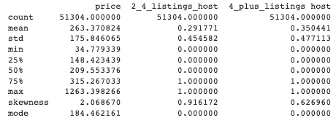
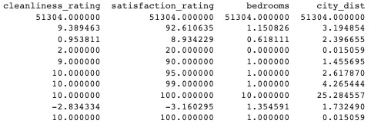
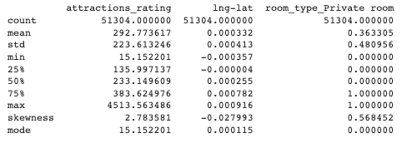
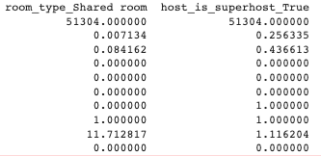
Descriptive Characteristics

Slide 5
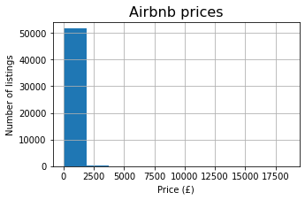
Histogram Analysis:
The Airbnb rental prices are mostly distributed under £2500, indicating that most of the data is concentrated on one end of the distribution. This type of distribution is commonly referred to as a "skewed right" distribution.
To make this visualization more comprehensive, we are going to look at the bins of the data to identify where we can cut the data. By doing this, we can create a more balanced histogram that accurately reflects the distribution of the data.

Slide 6
Here we see the distribution of the prices in different bins. As you see, most of the prices of the Airbnb rentals in Europe falls between 50 and 2000 pounds.
 | range | %
8 | (0, 50] | 0.096699
5 | (50, 100] | 5.883149
2 | (100, 150] | 19.589224
1 | (150, 200] | 20.521399
0 | (200, 350] | 32.889164
3 | (350, 500] | 10.990775
4 | (500, 1000] | 8.538496
6 | (1000, 1500] | 0.992129
7 | (1500, 2500] | 0.348115
10 | (2500, 3000] | 0.048349
11 | (3000, 3500] | 0.027076
9 | (3500, 18545] | 0.073491

Slide 7
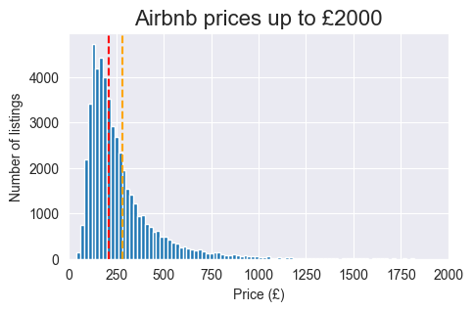
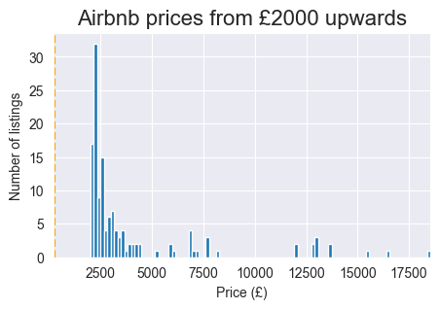
So, we cut the data in 2 pieces for better visualization.

Slide 8
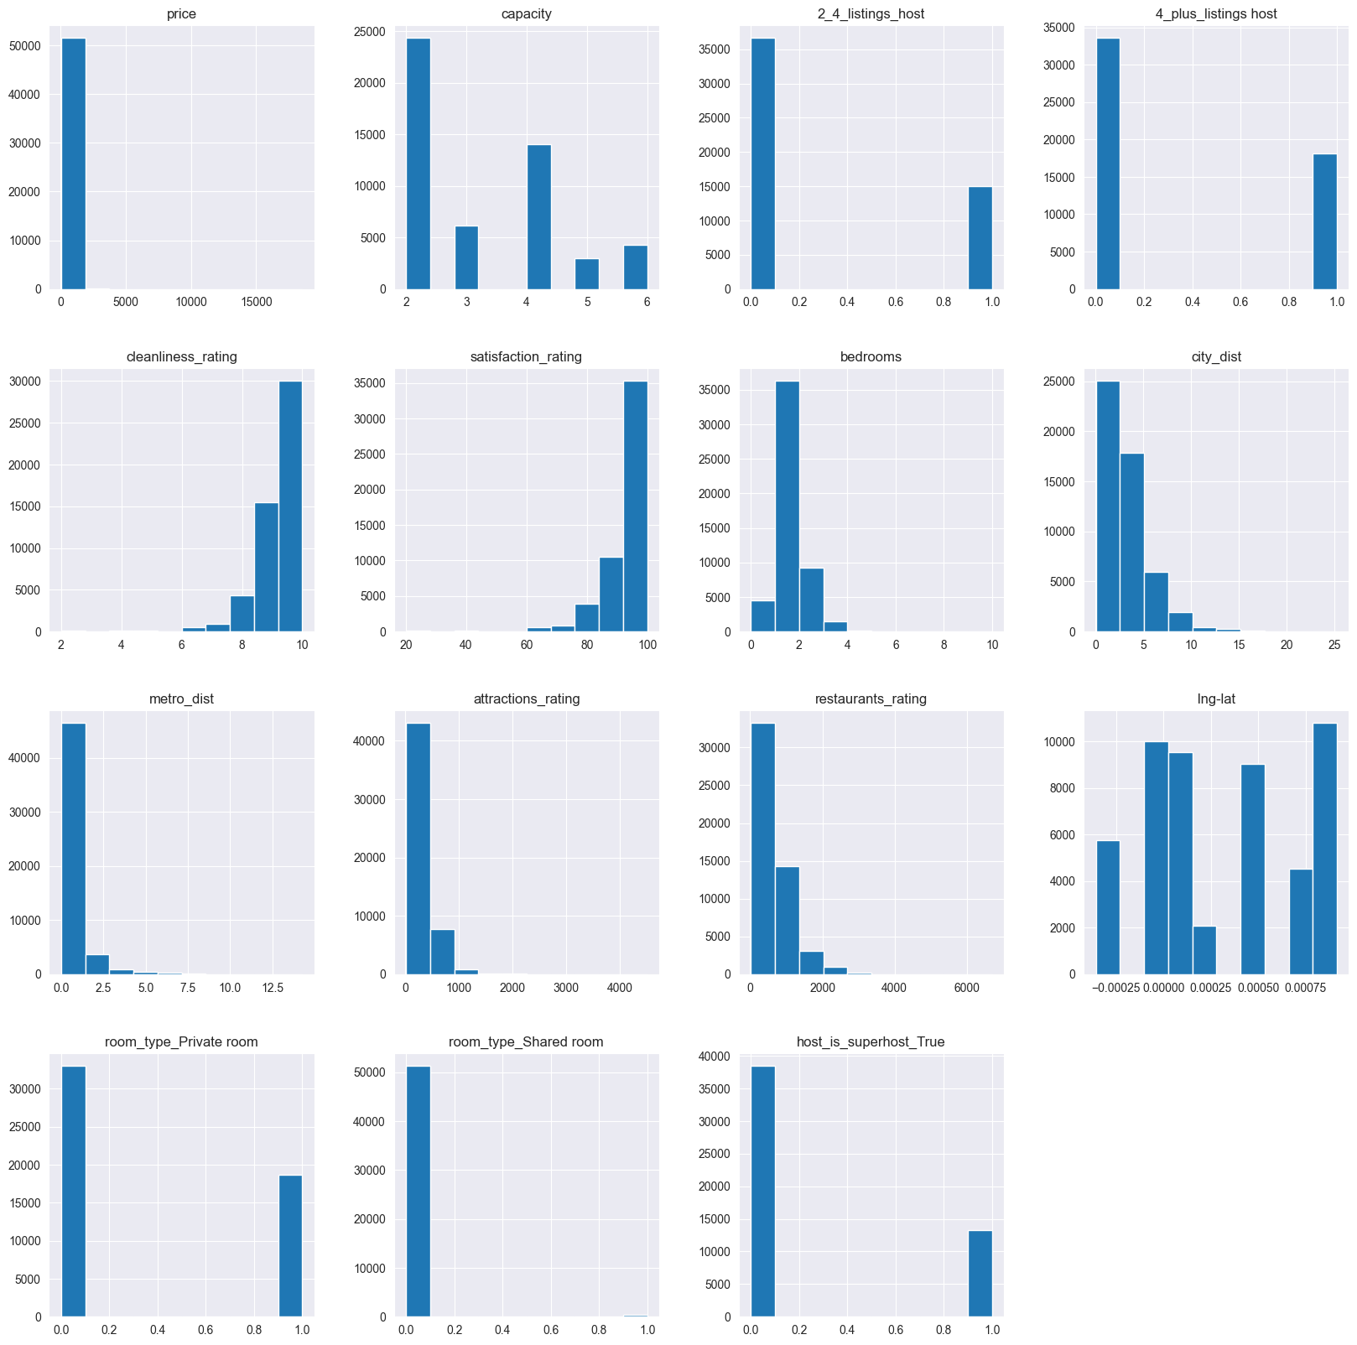
We can see a quick view of all the distributions of the data here. However, some data are Boolean or categorial which show as 0 or 1 or as dummy variables for categories. Our numerical data such as the price, number of the bedrooms, distance from the city center are shown as a destructions, some skewed to the right and some to left.

Slide 9
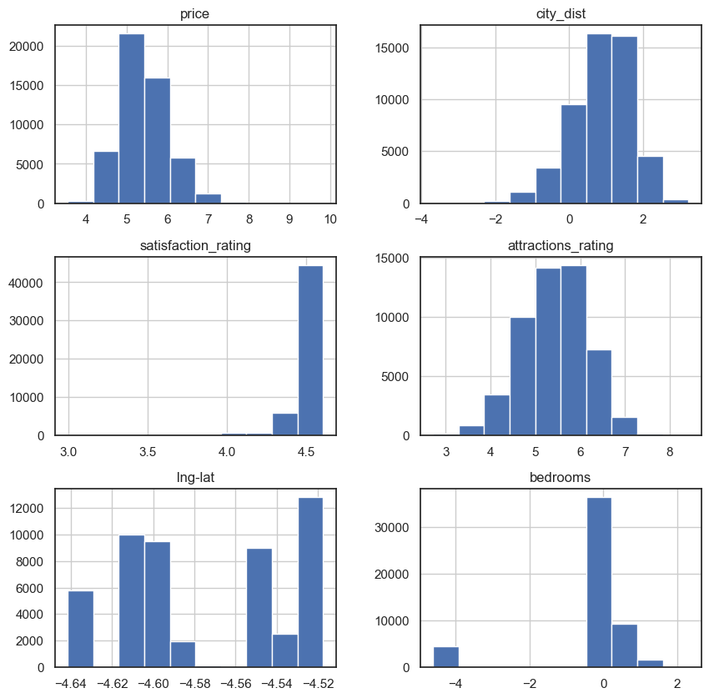
We converted our numerical data to a logarithmic distribution in order to better comprehend its distribution. This works by narrowing the range of values in a dataset, minimizing the impact of extreme values, and improving the symmetry of the distribution. We can find any underlying patterns or trends that might not have been obvious in the first dataset by converting our data to a log distribution. This can assist us in making better decisions and interpreting our facts with greater accuracy.

Slide 10
Attractions_rating: The histogram shows a normal distribution with no outliers. City_dist: The histogram shows a left-skewed distribution with no outliers. Satisfaction_rating: The histogram shows a left-skewed distribution with no outliers. Bedrooms: The histogram shows a left-skewed distribution with outliers on the lower end of the number of bedrooms.

Slide 11
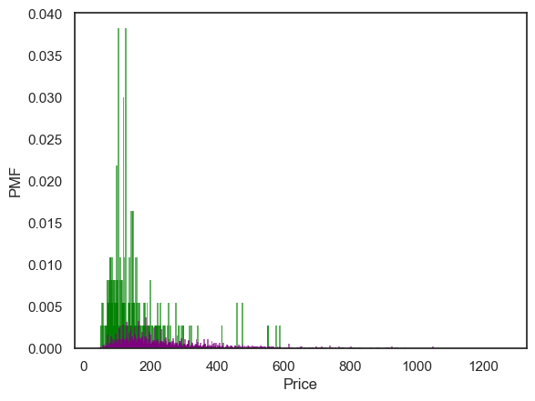
PMF Analysis: Two scenarios were compared based on the number of bedrooms and the type of room.
1. Comparing prices of shared rooms vs. non-shared rooms (Private and Entire apartments) based on price.
Based on the two probability mass functions, it seems that in the first scenario we have a left-skewed distribution. However, shared rooms have a higher PMF compared to the second scenario of private/Entire apartment listings.
This suggests there are more instances where the price is skewed towards the lower end of the spectrum. This could be due to a variety of factors, such as increased competition in the market or lower demand for shared rooms.
In the PMF where the room type is not a shared room, we may have a more diverse range of prices, with fewer instances where the price is very low.

Slide 12
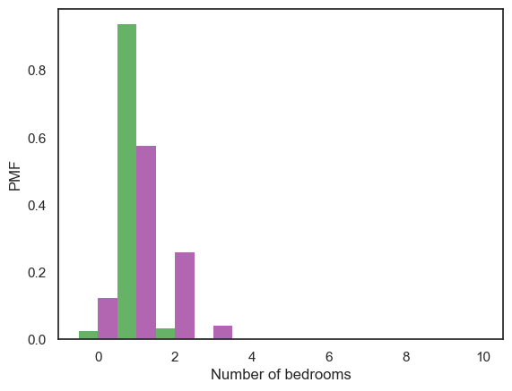
Similarly, to the first scenario, in the private rooms, there are more instances where the number of bedrooms is skewed towards the lower end of the spectrum. This suggests that private rooms are more likely to have fewer bedrooms than non-private rooms. In the PMF where the room type is not a private room, there is a lower peak and a lower PMF, which indicates that non-private rooms are more likely to have a higher number of bedrooms compared to private rooms.
2. Comparing number of bedrooms of private rooms vs. non-private rooms (Private and Entire apartments) based on price.

Slide 13
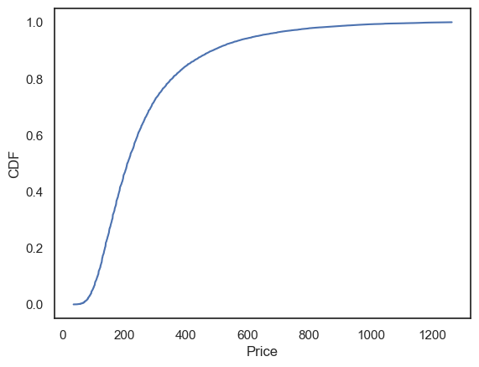
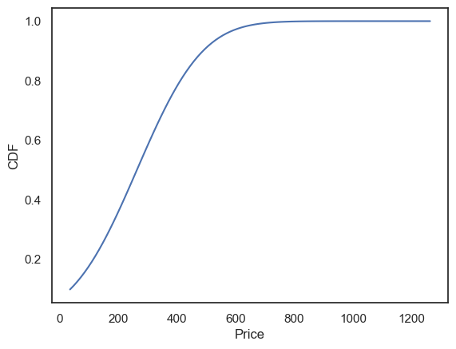
CDF Analysis: The cumulative distribution function was created to show the distribution of the price variable. Analytical Distribution Analysis. A normal analytical distribution was applied to the price variable to show how the data fits the normal distribution curve.
Analytical distribution
The shape of the CDF curve suggests that the distribution of prices in the data is skewed to the right, with a longer tail on the right-hand side of the curve. This means that there may be some high-priced outliers in the data that are driving up the mean or average price.

Slide 14

Outliers
We calculated outliers of the prices in my data using z-scores. Using 3 standard deviation above and below the mean, we found that the minimum outlier price is at 1263.9 pounds in our listings.
We then removed the outliers of the price so they won't affect our distribution.

Slide 15
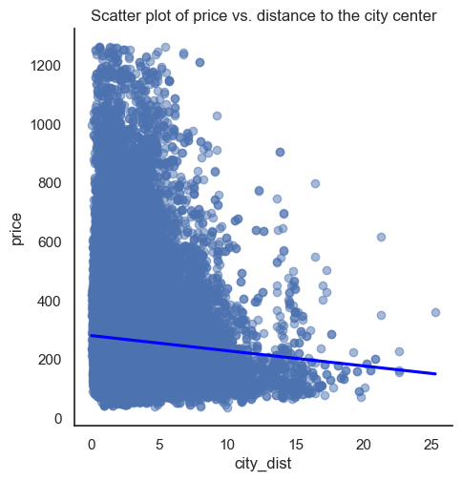
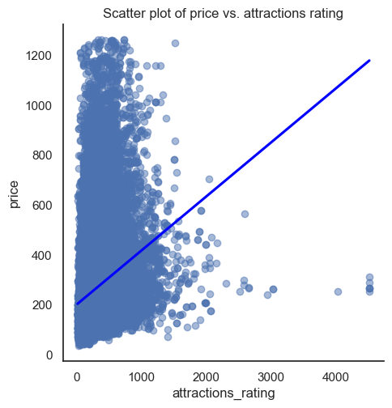
Scatter plots
Two scatter plots are created to compare the correlation and causation between two variables:
Price vs distance from the city center: A negative correlation between the 2 variables can be seen and this can be because as we step away from the center of the city, there is less demand for temporary stay for tourists.
Price vs attractions rating: A positive correlation between the two can be seen as the attractions near the listings are rated higher, the demand for stay can be higher.

Slide 16
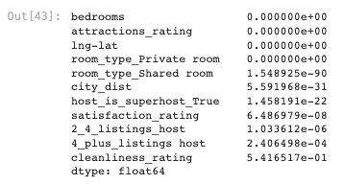
Regression Analysis: A regression analysis was conducted on the dependent variable, price, and all the explanatory variables. The analysis shows that all variables are statistically significant in predicting the rental prices in Europe. The coefficients of determination (R-squared) are 0.31, 0.46, 0.52 and 0.55 respectively for our linear regression model, 2nd , 3rd and 4th degree polynomial regressions, which means that our best model being the 4th degree Polynomial regression explains 55% of the variability in rental prices can be explained by the model.
P-values

